Slide 1
Stress management
Emotions and Moods

Slide 2
After studying this chapter you should be able to:
Differentiate between emotions and moods.
Discuss whether emotions are rational and what functions they serve.
Describe the validity of potential sources of emotions and moods.
Show the impact emotional labor has on employees.
Describe affective events theory and its applications.
Contrast the evidence for and against the existence of emotional intelligence.
Identify strategies for emotion regulation and their likely effects.
Apply concepts about emotions and moods to specific OB issues.

Slide 3
Why Were Emotions
Excluded from OB Study?
Historically, emotions in the workplace were thought to be detrimental
Managers tried to create emotion-free organizations
This thinking is changing
  Some emotions hinder performance, some are neutral, and some are constructive
Notes:
Historically the study of organizational behavior has not given much attention to emotions. Emotions were typically seen as irrational so managers tended to work to make the workplace emotion-free.
Often managers viewed emotions as disruptive to the workplace and therefore a hindrance to productivity. However, when thinking about emotions, typically managers were focusing on negative emotions. Even though there are some negative emotions that could hinder productivity, there is no doubt that workers bring their emotions to the workplace. Therefore, any study in organizational behavior would not be complete without considering the roles of emotions in the workplace.

Slide 4
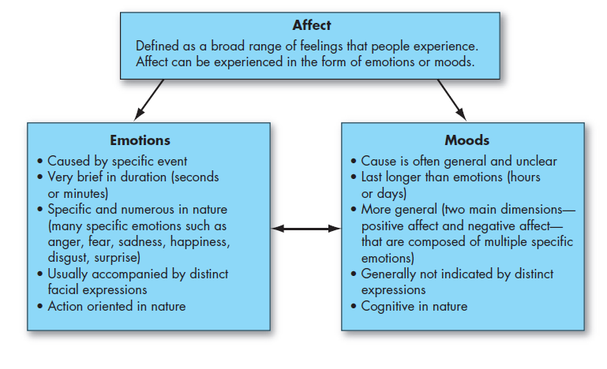
Affect, Emotions, and Moods
Notes:
Affect is a generic term that covers a broad range of feelings people experience. This includes both emotions and moods. Emotions are intense feelings that are directed at someone or something. Moods are the feelings that tend to be less intense than emotions and that lack a contextual stimulus.

Slide 5
The Basic Emotions
Six universal emotions
  Anger
  Fear
  Sadness
  Happiness
  Disgust
  Surprise
Notes:
Many researchers agree on six essentially universal emotions – anger, fear, sadness, happiness, disgust, and surprise. Some even plot them along a continuum: happiness – surprise – fear – sadness – anger – disgust. The closer two emotions are to each other on this continuum, the more likely people will confuse them.

Slide 6
The Basic Moods:
Positive and Negative Affect
Positive affect: a mood dimension consisting of positive emotions such as excitement, enthusiasm, and elation at the high end (high positive affect) and boredom, depression, and fatigue at the low end (low positive affect)
Negative affect: a mood dimension consisting of nervousness, stress, and anxiety at the high end (high negative affect) and contentedness, calmness, and serenity at the low end (low negative affect)
Notes:
Our basic moods carry positive and negative affects; they cannot be neutral. Emotions are grouped into general mood states.

Slide 7
Experiencing Moods and Emotions
Positive moods are somewhat more common than negative moods
  Positivity offset: at zero input, most people experience a mildly positive mood
Notes:
The degree to which people experience positive and negative emotions varies across cultures. Some cultures value certain emotions more than others, which leads individuals to change their perspective on experiencing those emotions.

Slide 8
The Function of
Emotions and Moods
Emotions and Rationality
  Emotions are critical to rational thought: they help us understand the world around us
Emotions and Ethics
  New research suggests that ethical behavior may be based to some degree on emotions and feelings
Notes:
There are some who think that emotions are linked to irrationality and expressing emotions in public may be damaging to your career or status. However, research has shown that emotions are necessary for rational thinking.
People who are behaving ethically are at least partially making decisions based on their emotions and feelings.
Emotions help us make better decisions and help us understand the world around us. If we are going to make decisions, we need to incorporate both thinking and feeling.

Slide 9
Sources of Emotions and Moods
Personality
  Some people experience certain moods and emotions more frequently than others
  Affect intensity: experiencing the same emotions with different intensities
Time of day
  People vary in their moods by time of day
Day of the week
  People tend to be in their best mood on the weekend
Notes:
Affectively intense people experience both positive and negative emotions more deeply. Many are happier toward the end of the week or mid-day.

Slide 10
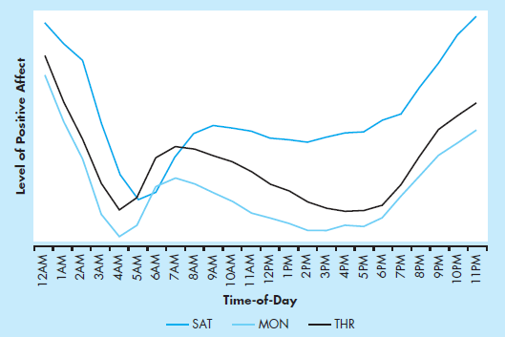
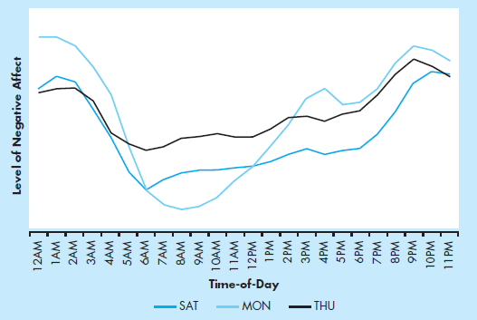
Sources of Emotions and Moods
Time-of-Day Effects on Moods of U.S. Adults as Rated from Twitter Postings
Notes:
Levels of positive affect are greatest in the evening, and the lowest in the early morning, on most days of the week. Levels of negative affect are also the highest in the overnight hours, but the lowest point is later in the morning than for positive affect.

Slide 11
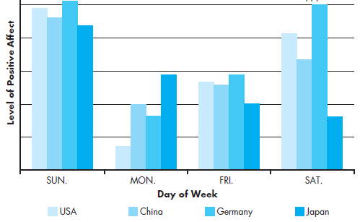
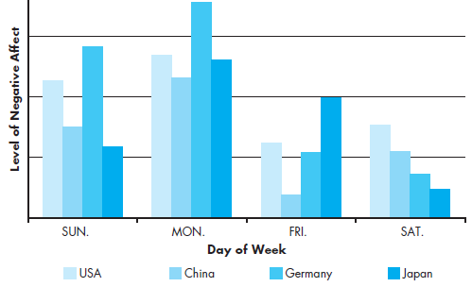
Sources of Emotions and Moods
Day-of-Week Mood Effects across Four Cultures
Notes:
In most cultures, people experience their highest positive affect on Friday, Saturday, and Sunday, and their lowest on Monday.

Slide 12
More Sources
Weather
  No impact according to research
Stress
  Increased stress worsens moods
Social Activities
  Physical, informal, and epicurean activities increase positive mood
Sleep
  Lack of sleep increases negative emotions and impairs decision making
Notes:
Weather is thought to have an impact on our emotions, but there is no proven effect.
Stress is an important factor and even at low levels it can cause our mood to change. It is important to maintain a low level of stress to help us control our psychological, as well as our physical health. Social activities have been shown to have a positive impact on our moods. This could be physical outlets such as playing in a basketball league, or it can be going out to dinner with friends. These types of activities are found to have a positive impact on our moods.
Sleep can be another factor; it is important to get enough, and high quality levels of sleep.

Slide 13
Even More Sources
Exercise
  Mildly enhances positive mood
Age
  Older people experience negative emotions less frequently
Sex
  Women show greater emotional expression, experience emotions more intensely, and display more frequent expressions of emotions
  Could be due to socialization
Notes:
Physical activity can also aid in keeping our moods upbeat.
Some characteristics that are beyond our control can impact our moods, such as age and gender. Elderly people tend to have fewer negative emotions. Women tend to express their emotions readily, and their moods tend to last longer. Research has shown that this is due to more cultural socialization than to biology.

Slide 14
Emotional Labor
Emotional labor: an employee’s expression of organizationally desired emotions during interpersonal transactions at work
Emotional dissonance: when an employee has to project one emotion while simultaneously feeling another
Notes:
In many jobs there is an implied agreement on the types of emotions that should be expressed. For example, waitresses are supposed to be friendly and cheerful whether they are currently feeling that emotion or not. When employees don’t feel the emotion they are required to express, they may experience emotional dissonance. This can lead to burnout and frustration with the job.

Slide 15
Felt vs. Displayed Emotions
Felt Emotions:
  The individual’s actual emotions
Displayed Emotions:
  The learned emotions that the organization requires workers to show and considers appropriate in a given job
  Surface Acting - hiding one’s true emotions
  Deep Acting - trying to change one’s feelings based on display rules
Notes:
An employee’s actual emotions are their felt emotions and this is in contrast to the emotions that are required or deemed appropriate, which are called displayed emotions. There are two levels of displayed emotions that can be expressed. They are both appropriately called acting. Surface acting occurs when an employee displays the appropriate emotions even when he doesn’t feel those emotions. Deep acting occurs when the employee actually changes her internal feelings to match displayed rules. This level of acting can be very stressful.

Slide 16
Affective Events Theory
How do emotions and moods influence job performance and satisfaction?
Affective events theory (AET): employees react emotionally to things that happen to them at work, and this reaction influences their job performance and satisfaction
Notes:
AET provides us with valuable insights into the role emotions play in primary organizational outcomes of job satisfaction and job performance.

Slide 17
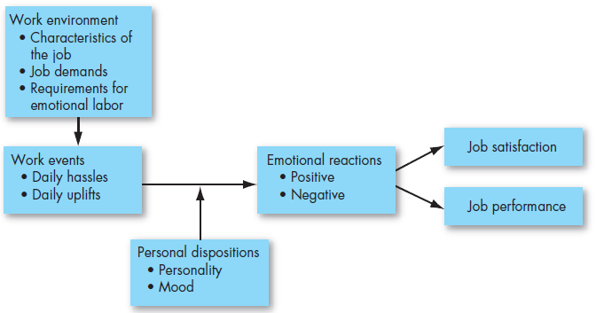
Affective Events Theory
Affective Events Theory
Notes:
Work events trigger positive or negative emotional reactions, to which employees’ personalities and moods predispose them to respond with greater or lesser intensity.
Emotions influence performance and satisfaction variables such as organizational citizenship behavior, organizational commitment, level of effort, intention to quit, and workplace deviance.

Slide 18
Emotional Intelligence
Emotional intelligence: a person’s ability to:
  Perceive emotions in the self and others
  Understand the meaning of these emotions
  Regulate one’s emotions in a cascading model
Notes:
Emotional Intelligence (EI) is a growing area of study and becoming increasingly important in the understanding of how individuals behave. EI is pulling in one’s understanding of emotions and their impact on behavior. Individuals who are emotionally intelligent will have a strong sense of self-awareness, recognizing their own emotions when experienced. They are also able to detect emotions in others. By understanding their own emotions and those of others, they can manage emotional cues and information to make decisions.

Slide 19
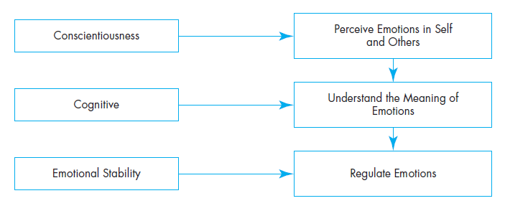
Emotional Intelligence
A Cascading Model of Emotional Intelligence
Notes:
People who know their own emotions and are good at reading emotional cues are most likely to be effective.

Slide 20
Emotional Intelligence on Trial
The case for:
The case against:
Intuitive appeal – it makes sense
EI predicts criteria that matter –positively correlated to high job performance
Study suggests that EI is neurologically based
EI is too vague a concept
EI can’t be measured
EI is so closely related to intelligence and personality that it is not unique when those factors are controlled
Notes:
EI plays a very important role in job performance; however, the jury is still out on the role EI plays in effectiveness in organizations.
The case for EI is based on the fact that it makes sense and appeals to our intuitive thinking. It tends to predict things that matter and are positively correlated to high job performance. Many studies have shown that EI is neurologically based and thus helpful in predicting behavior.
However, EI has its critics as the concept can be seen as too vague and not easily measured. Since it is so closely related to intelligence and personality theories, it is not seen as unique when these factors are controlled.

Slide 21
Emotion Regulation
Emotion regulation: identifying and modifying the emotions you feel
Effective emotion regulation techniques include:
  Acknowledging emotional responses to situations
  Venting
Notes:
Emotion regulation involves identifying and modifying the emotions you feel. Research on effective emotion regulation techniques is ongoing, but studies show that acknowledging, rather than suppressing, our emotional responses to situations and reevaluating events after they occur can be effective, as can open expression of emotions, or venting.

Slide 22
OB Applications of
Emotions and Moods
Selection – Employers should consider EI a factor in hiring for jobs that demand a high degree of social interaction
Decision Making – Positive emotions can increase problem-solving skills and help us understand and analyze new information
Creativity – Positive moods and feedback may increase creativity
Notes:
There are numerous applications of emotions and moods. These include selection of employees, decision making, and creativity.

Slide 23
More OB Applications of Emotions and Moods
Motivation – Promoting positive moods may give a more motivated workforce
Leadership – Emotions help convey messages more effectively
Negotiation – Emotions may impair negotiator performance
Customer Service – Customers “catch” emotions from employees, called emotional contagion
Notes:
Motivation, leadership, negotiation, and customer service are also work outcomes that are impacted by emotions and moods, and it is important for managers to understand the connection.

Slide 24
Even More OB Applications of Emotions and Moods
Job Attitudes – Emotions at work get carried home but rarely carry over to the next day
Deviant Workplace Behaviors – Those who feel negative emotions are more likely to engage in deviant behavior at work
Safety and Injury at Work – Bad moods can contribute to injuries on the job
Notes:
Job attitudes can influence our home life but don’t always get carried back to the workplace. However, deviant workplace behaviors are often the result of negative emotions and significantly impact the workplace. Negative emotions can also lead to increased injuries at work.

Slide 25
Implications for Managers
Recognize that emotions are a natural part of the workplace and good management does not mean creating an emotion-free environment
To foster creative decision making, creativity, and motivation in employees, model positive emotions and moods as much as is authentically possible
In the service sector, encourage positive displays of emotion, which make customers feel more positive and thus improve customer service interactions and negotiations
Managers who understand the role of emotions and moods will significantly improve their ability to explain and predict their coworkers’ and employees’ behavior
Notes:
In summary, moods and emotions are important to the study of organizational behavior. Also, they are natural expressions and managers should not try to completely control the employees’ emotions, but they should be aware of the emotions and not ignore emotional indicators. The more you understand the emotions of your employees, the better you will be able to predict their behavior.

Slide 26
Summary
Differentiated between emotions and moods.
Discussed whether emotions are rational and what functions they serve.
Described the validity of potential sources of emotions and moods.
Showed the impact emotional labor has on employees.
Described affective events theory and its applications.
Contrasted the evidence for and against the existence of emotional intelligence.
Identified strategies for emotion regulation and their likely effects.
Applied concepts about emotions and moods to specific OB issues.

Slide 27
